Slide 1
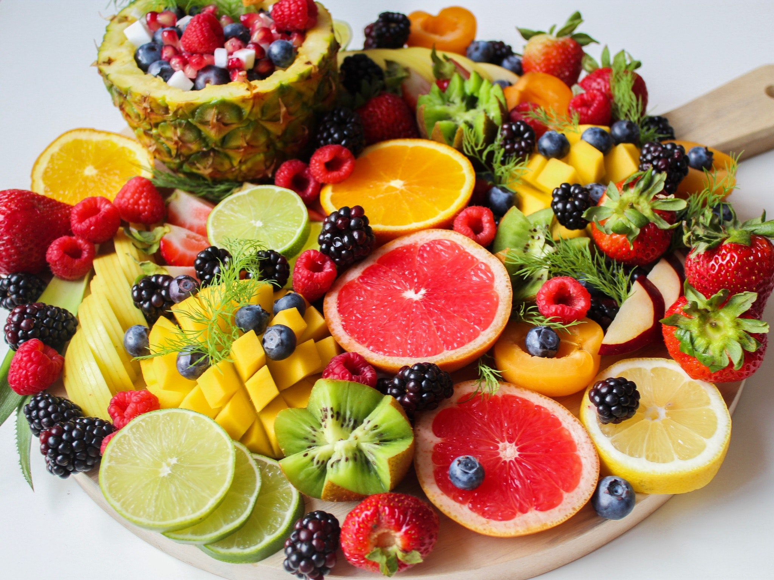
Prebiotics And Your Immunity

Slide 2
When it comes to your immunity, the gut has been found to have an important part to play.

Slide 3
The Role Of The Gut In Immunity
Most of us know that keeping our gut healthy is important, and this involves maintaining a healthy gut microbiota.

Slide 4
Researchers have discovered and recognized that the body’s other organ systems can be influenced by the gut environment and it’s now becoming realized that poor gut health could cause many diseases and conditions like lung disease or depression.

Slide 5
Our immune systems form the primary link between the gut bacteria and the way in which they influence our well-being.

Slide 6
We’re all born with an underdeveloped immune system and therefore rely on the antibodies provided by our mothers at first, but our immune cells then learn the best ways of protecting our bodies from illnesses once all the material antibodies have worn away.

Slide 7
Research has shown that gut bacteria maintains balance in our immune systems.

Slide 8
Things like food additives, the non-pathogenic microorganisms found in dirt or dust, and pollen in the air we breathe all enter our bodies.

Slide 9
For those with an impaired immune system, inflammatory responses are triggered each time a new food is tried or each time a new substance is encountered.

Slide 10
This tolerance is known as oral tolerance. It can be established by maintaining diverse gut flora with lots of different fungi, microorganisms and bacteria to teach the immune system’s cells which invaders are bad and which can be safely overlooked.

Slide 11
If the balance is off, the immune system may adopt an increased inflammatory state that goes on to affect the other systems in the body, increasing the chances of developing a range of diseases including Type I and II diabetes, depression and obesity.

Slide 12
Although most bacteria are beneficial, there are some that cause diseases to progress.

Slide 13
This means that, when good bacteria become removed because of medication or dietary changes, some opportunistic pathogens move in to fill up the gap that remains.

Slide 14
It isn’t easy to permanently change the gut flora once it has been established.

Slide 15
So, for example, if you go abroad on vacation and eat different foods, your gut will return to normal on your return home.

Slide 16
However, imbalanced gut flora can loop in negative cycles, reinforcing harmful functions.

Slide 17
As a result, your immune system will be better-regulated and considerably more tolerant of change.

Slide 18
As a result, you will be more resistant to disease and illnesses.

Slide 19
What Are Prebiotics And How Can They Help?
Prebiotics are food components that are known to improve the supply of food for the microorganisms that live inside our gastrointestinal tracts.

Slide 20
It’s possible to boost the level of prebiotics in your body naturally by eating more vegetables and fruits.

Slide 21
How Can Prebiotics Be Added To The Diet?
There are a number of foods that are known to be beneficial prebiotics. These include:

Slide 22
Chicory root – popular thanks to its coffee-like taste, chicory root is a valuable source of prebiotics. This nourishes the bacteria in the gut, improves your digestion and relieves your constipation.

Slide 23
Not only that, but chicory root contains a lot of antioxidant compounds known to protect your liver from oxidative damage.

Slide 24
Dandelion greens – these greens are ideal for inclusion in a salad and they are an excellent source of fiber, containing as much as 4g of fiber in each 100g serving.

Slide 25
Dandelion greens have diuretic, antioxidant, anti-inflammatory, cholesterol-lowering, and anti-cancer effects that can help you to stay healthy and well.

Slide 26
Jerusalem artichokes – sometimes called the Earth Apple, the Jerusalem artichoke offers a host of health benefits. It supplies around 2g of dietary fiber in every 100g and 76 percent of this fiber is derived from inulin.

Slide 27
Not only that, but it is high in potassium and thiamine, both of which aid the nervous system, promoting good muscle function.

Slide 28
Garlic – this tasty herb has been linked with many health benefits. Around 11 percent of its fiber content is derived from inulin, with 6 percent coming from a naturally occurring sweet probiotic known as fructooligosaccharides.

Slide 29
These beneficial bacteria also help to prevent disease-promoting bacteria from growing.

Slide 30
Garlic also reduces the chance of developing heart disease thanks to its antimicrobial, anti-cancer and antioxidant effects.

Slide 31
Onions – these vegetables are versatile and tasty, but they also offer a host of health benefits, with inulin accounting for 10 percent of their fiber content and fructooligosaccharides making up another 6 percent.

Slide 32
As a result, the gut flora is strengthened while fat breakdown is aided, and the immune system boosted by increasing the production of nitric oxide in the cells.

Slide 33
Leeks – coming from the same vegetable family as garlic and onions, leeks offer similar benefits for your health.

Slide 34
Also, leeks have a high amount of flavonoids which help to support the body’s natural response to oxidative stress.

Slide 35
Asparagus – this popular vegetable represents another excellent prebiotic source, with around 2 to 3 grams of inulin content in every 100-gram serving.

Slide 36
By combining antioxidants and fiber, asparagus offers anti-inflammatory benefits.

Slide 37
Bananas – these popular fruits are rich in fiber, minerals and vitamins while also containing a small amount of inulin.

Slide 38
Barley – this cereal grain contains 3 to 8 grams of beta-glucan in every 100-gram serving.

Slide 39
It also lowers your LDL and total cholesterol and blood sugar while also being rich in selenium to boost thyroid function, provides antioxidant benefits and improves immunity.

Slide 40
Oats – healthy whole oat is a grain with prebiotic benefits. Oats contain a large amount of beta-glucan fiber together with some resistant starch.

Slide 41
Oats also offer anti-inflammatory and antioxidant protection for the body thanks to the phenolic acid they contain.

Slide 42
Apples – not only are apples delicious but pectin makes up around half of the total fiber content of an apple.

Slide 43
Its prebiotic advantages include its ability to increase butyrate – the short-chain fatty acid which feeds good bacteria in the gut while decreasing the number of bad bacteria.

Slide 44
Not only that, but apples have anti-inflammatory and antioxidant properties that help to reduce the chances of developing illnesses and diseases.

Slide 45
Konjac root – sometimes called elephant yam, is a tuber that can sometimes be used as a supplement to offer health benefits.

Slide 46
It contains 40 percent glucomannan fiber which is an extremely viscous dietary fiber.

Slide 47
It also reduces your blood cholesterol levels and helps to promote weight loss while also improving how your body metabolizes carbohydrates.

Slide 48
Cocoa – cocoa beans aren’t just delicious, they’re also very healthy.

Slide 49
Cocoa is one of the best sources of flavanols which has a number of powerful prebiotic benefits, helping to boost the growth of good gut bacteria while benefiting your heart health.

Slide 50
Burdock Root – popular in Japan, burdock root offers many health benefits, containing around 4 grams of fiber in every 100-gram serving, with most of this fiber being from inulin and FOS.

Slide 51
Burdock root also offers anti-inflammatory and antioxidant properties while lowering your blood sugar levels.

Slide 52
Flaxseeds – these seeds are very healthy and an excellent source of prebiotics.

Slide 53
Containing around 20-40 percent soluble fiber from mucilage gums and 60-80 percent insoluble fiber from lignin and cellulose, the fiber found in flaxseeds boosts the number of good bacteria in your gut, promoting healthy bowel movements and reducing the amount of fat in your diet that you absorb and digest.

Slide 54
Yacon root – similar to sweet potato, yacon root is packed with fiber, especially prebiotic FOS (fructooligosaccharides) and inulin.

Slide 55
Also, yacon root contains phenolic compounds that boost its antioxidant properties.

Slide 56
Jicama root – this root is high in fiber but low in calories. It contains a lot of inulin, a prebiotic fiber that helps to boost your digestive health, enhance your sensitivity to insulin and lower your blood sugar level.

Slide 57
Wheat bran – this outer layer of whole wheat grain is a great prebiotic source that contains a special kind of fiber made up of AXOS (arabinoxylan oligosaccharides).

Slide 58
AXOS fiber makes up as much as 64-69 percent of the fiber content of wheat bran and allows it to boost the levels of good Bifidobacteria inside the gut.

Slide 59
Grains that are rich in AXOS also offer anti-cancer and antioxidant properties.

Slide 60
Seaweed – although seaweed isn’t eaten often, it’s a powerful prebiotic to add to your diet. Around 50 to 85 percent of the fiber content of seaweed is derived from the water-soluble fiber.

Slide 61
Also, seaweed is rich in the antioxidants that have been associated with strokes and heart attack prevention.

