Slide 1
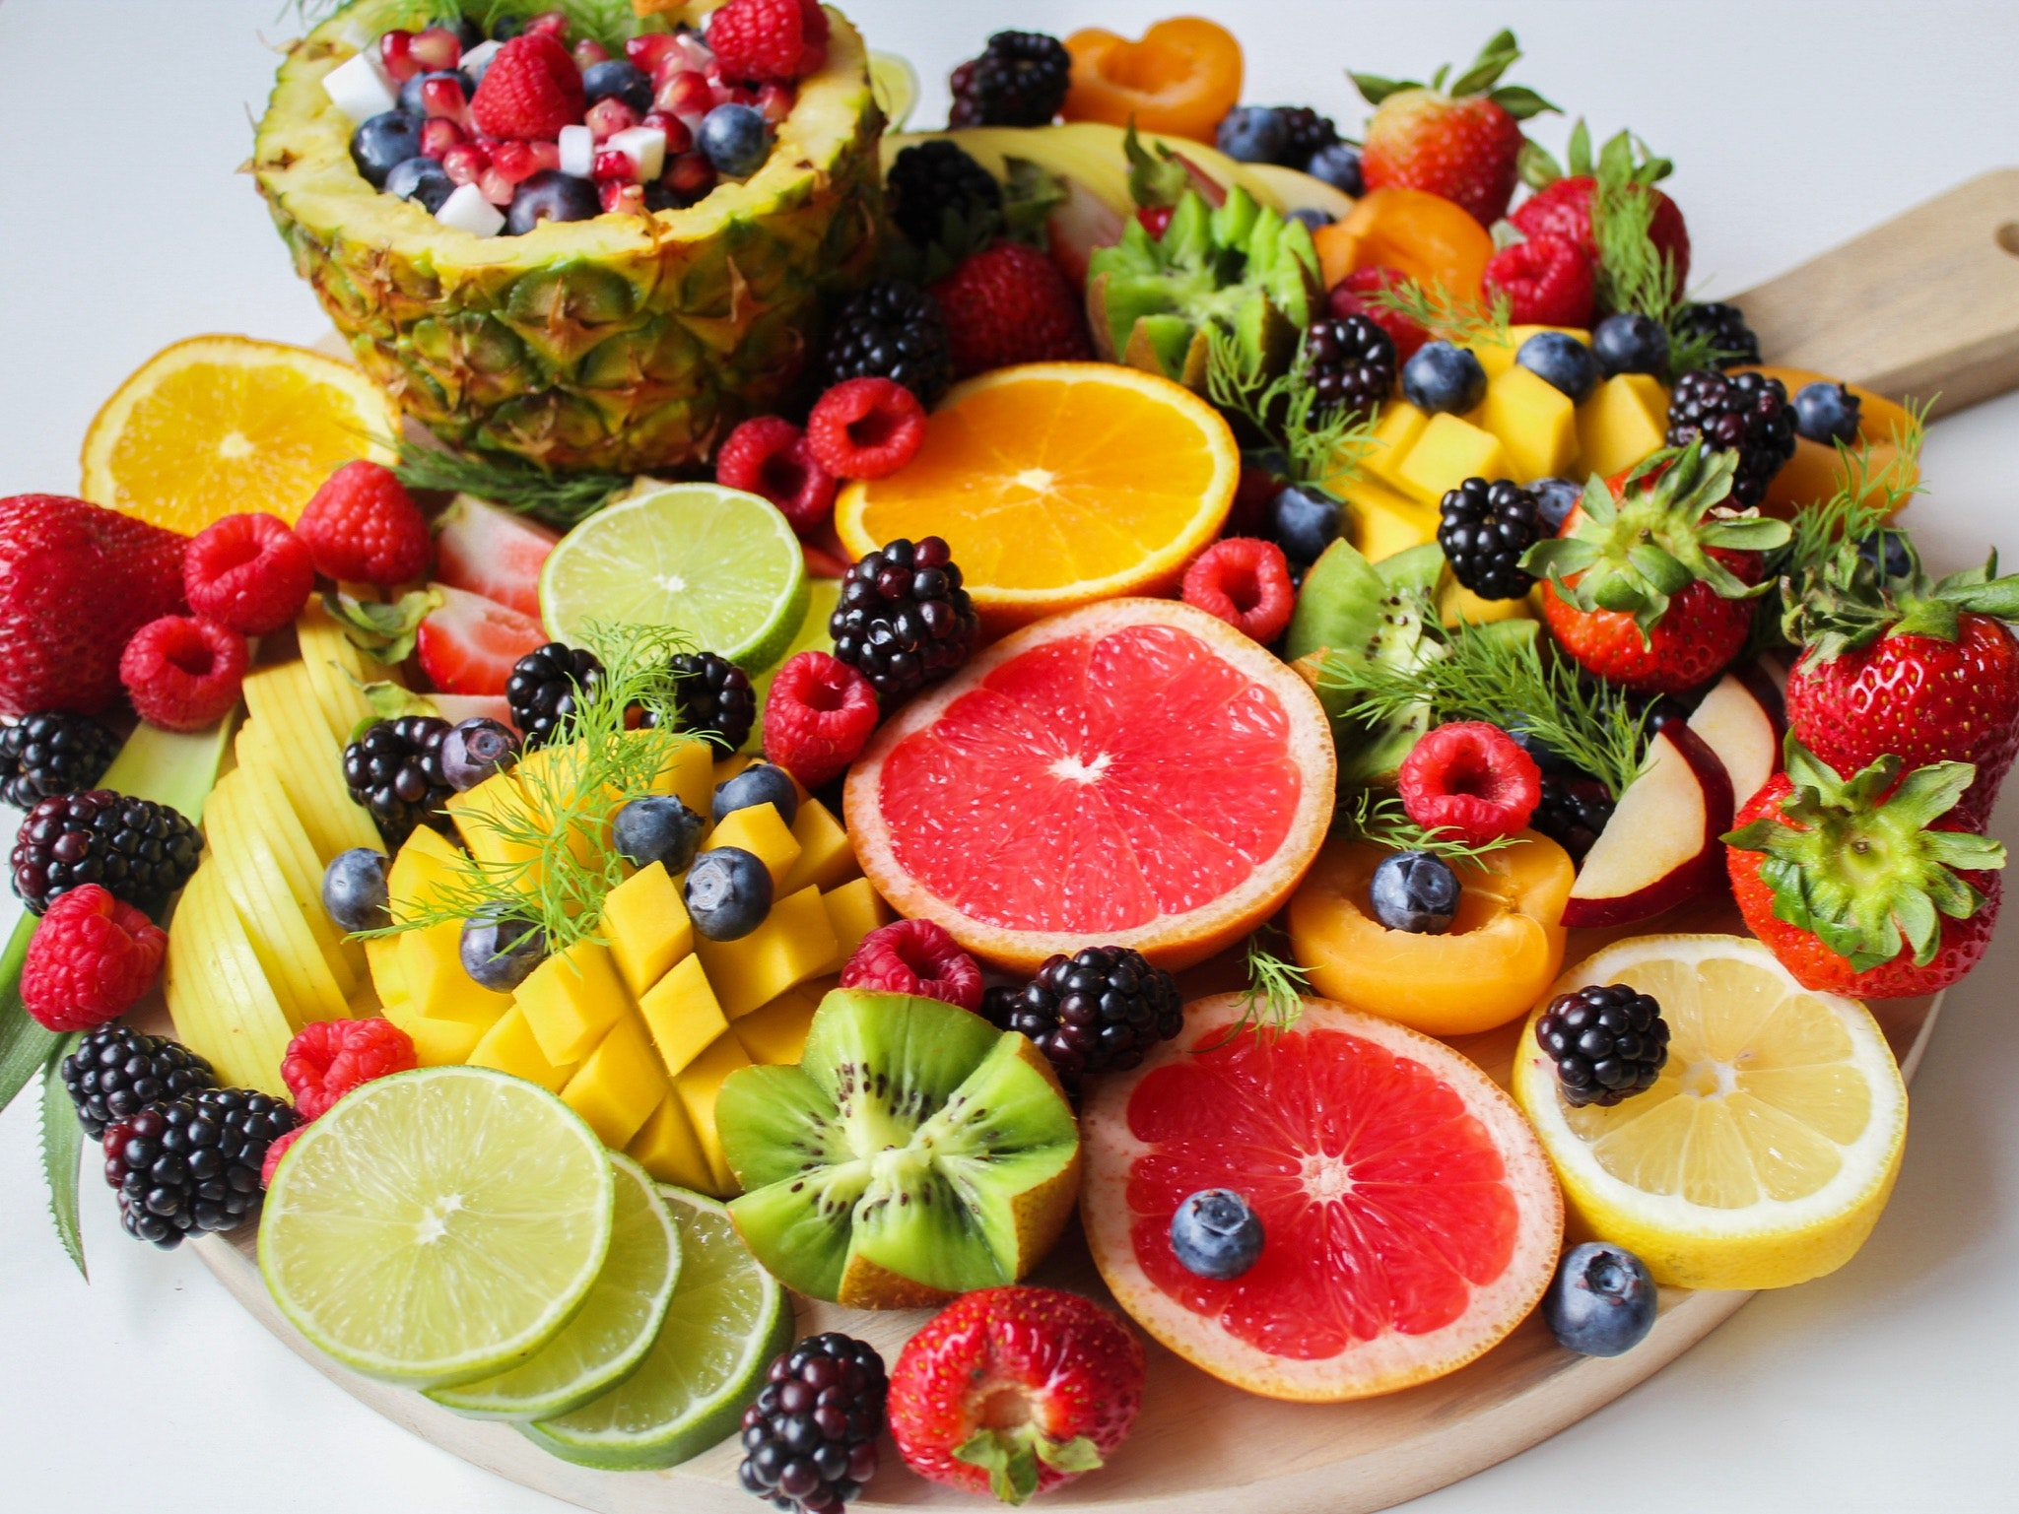
Plant Foods And Their Cancer Fighting Properties

Slide 2
A strong link has been found between the development of cancer and a weakened immune system, so it’s imperative to find ways of boosting immunity to aid the fight against this life-threatening disease.

Slide 3
Cancer And The Immune System
There are specific cancers that directly affect the immune system such as leukemia and lymphoma.

Slide 4
However, all kinds of cancer impact immunity.

Slide 5
Cancer cells are created from the body’s own cells, and therefore, the immune system sometimes fails to recognize that it needs to attack them.

Slide 6
In some cases, cancer cells may even switch off the body’s immune response making sure immune cells cannot attack them.

Slide 7
This happens when cancer itself, or the treatments given to combat the disease, affect the bone marrow.

Slide 8
The blood cells are produced inside the bone marrow, so when it’s impacted by cancer, radiation or chemotherapy, it produces fewer blood cells than usual.

Slide 9
Plant Foods And Their Role In Combating Cancer
There has been some evidence to suggest vegetarians are better able to resist cancer, and it’s believed that this happens because plant-based foods like vegetables, fruits, nuts, legumes and wholegrains contain plenty of nutrients.

Slide 10
This is because plants produce plant chemicals called phytochemicals that can protect the cells from being damaged.

Slide 11
Finally, plant-based diets are, in general, lower in calories, and this helps us to maintain a healthy bodyweight which, again, reduces the risk of developing cancer.

Slide 12
An extra 3.5 oz of red meat each day increases the risk of developing polyps in the colon by up to 2 percent, and just 1.25 oz of processed meat each day increases this risk by a massive 29 percent.

Slide 13
Which Plant Foods Should I Include In My Diet?
A plant-based diet emphasizes the consumption of minimally processed, wholefoods while limiting or avoiding animal products.

Slide 14
Some of the foods you should add to your daily diet include:
Fruits such as citrus fruits, berries, peaches, pears, bananas, and pineapple
Vegetables like kale, spinach, broccoli, tomatoes, carrots, cauliflower, peppers, and asparagus

Slide 15
Starchy vegetables such as sweet potatoes, potatoes, and butternut squash
Wholegrains like brown rice, farro, rolled oats, quinoa, pasta, barley, and brown rice

Slide 16
Healthy fats like olive oil, avocados, coconut oil and unsweetened coconut oil
Legumes like peas, lentils, chickpeas, black beans, and peanuts

Slide 17
Nuts, seeds and nut butters like cashews, almonds, pumpkin seeds, macadamia nuts, tahini, and natural peanut butter
Unsweetened plant-based milk like almond, cashew, or coconut milks

Slide 18
Herbs, spices and seasonings like rosemary, basil, curry, turmeric, salt, and black pepper
Condiments like mustard, salsa, soy sauce, lemon juice, vinegar, and nutritional yeast

Slide 19
Plant-based proteins like tempeh and tofu
Beverages like tea, coffee, and water

Slide 20
Certain foods should also be avoided. These include:
Fast food
Added sweets and sugars
Refined grains

Slide 21
Convenience and packaged foods
Processed vegan foods
Artificial sweeteners
Processed animal products

