Slide 1
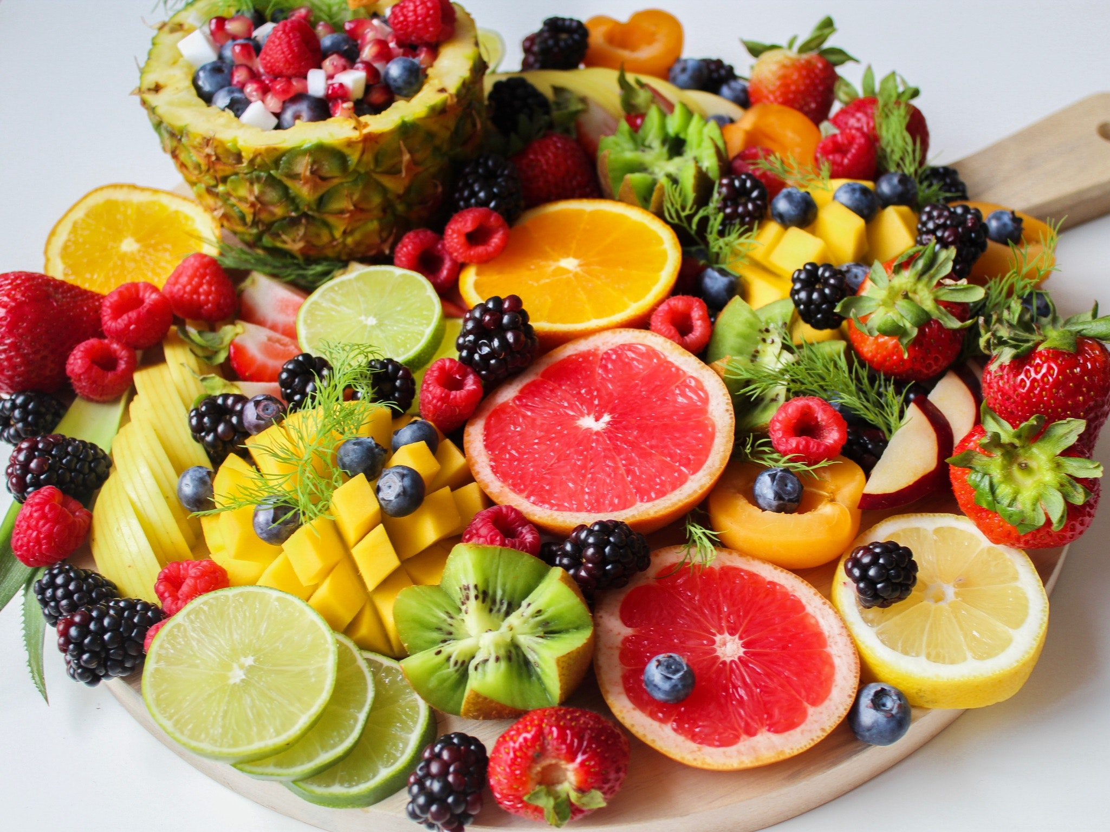
Antioxidants And Immune Health

Slide 2
Antioxidants have recently been shown to have a powerful part to play in improving your immunity and overall well-being.

Slide 3
But what are they, and how do they work?

Slide 4
What Are Antioxidants?
Antioxidants are substances that are known to slow down or even prevent the damage caused to the body’s cells by free radicals – the unstable molecules produced by the body in reaction to environmental factors and other stresses.

Slide 5
Some plant-based foods are believed to be packed with antioxidants, and plant-based antioxidants are a form of phytonutrient.

Slide 6
Some antioxidants are produced by the body itself. These are known as endogenous antioxidants.

Slide 7
Antioxidants are known to protect against oxidative stress – the cell damage caused by free radicals in the body.

Slide 8
Some of the processes and activities that can cause oxidative stress include:
Excessive exercise
Mitochondrial activity
Ischemia and reperfusion damage

Slide 9
Tissue trauma because of injury or inflammation
Smoking

Slide 10
Consuming processed and refined foods, artificial sweeteners, trans fats and certain additives and dyes

Slide 11
Environmental pollution
Exposure to drugs, pesticides and chemicals
Radiation

Slide 12
Ozone
Industrial solvents

Slide 13
When cell damage occurs, the result can be:
Excess release of free copper or iron ions
Activation of phagocytes, one of the white blood cell types that combat infection

Slide 14
Disruption in the electron transport chains
Increased enzymes that generate more free radicals
These all cause oxidative stress.

Slide 15
Oxidative stress is linked to vision loss, atherosclerosis, and cancer due to cell changes caused by free radicals.

Slide 16
The Role Of Free Radicals
Free radicals are waste substances created by cells when the body reacts to its environment and processes food.

Slide 17
Oxidative stress caused by free radicals is linked with a host of diseases including cancer, heart disease, strokes, arthritis, immune deficiency, respiratory diseases, Parkinson’s disease, emphysema, and other ischemic and inflammatory conditions.

Slide 18
Which Foods Contain Antioxidants?
It’s believed there are hundreds or even thousands of antioxidants.

Slide 19
Some examples of antioxidants include:
Vitamin A
Vitamin C
Vitamin E
Beta-Carotene

Slide 20
Lutein
Lycopene
Selenium
Zeaxanthin
Manganese

Slide 21
Flavonoids, catechins, flavones, phytoestrogens and polyphenols are all forms of antioxidants found in plant-based food.

Slide 22
All antioxidants serve their own function and cannot be interchanged with others.

Slide 23
Some foods that are known to be rich sources of antioxidants include:
Vitamin A – liver, eggs, and dairy products
Vitamin C – vegetables and fruits including bell peppers, oranges, and berries

Slide 24
Vitamin E – seeds and nuts, vegetable and sunflower oils, and leafy green vegetables
Beta-carotene – vegetables and fruits in bright colors like peas, mangos, carrots, and spinach

Slide 25
Lycopene – red and pink vegetables and fruits like watermelon and tomatoes
Lutein – leafy green vegetables, oranges, papaya, and corn
Selenium – corn, rice, wheat, nuts, wholegrains, legumes, cheese, and eggs

Slide 26
Other foods said to be good antioxidant sources include:
Legumes like kidney beans and black beans
Eggplants
Black and green teas

Slide 27
Red grapes
Pomegranates
Dark chocolate
Goji berries

Slide 28
It’s important to note that cooking certain foods may decrease or increase their level of antioxidants.

Slide 29
Conversely, zucchini, peas and cauliflower all lose some of their antioxidant potency when they’re cooked.

