Slide 1
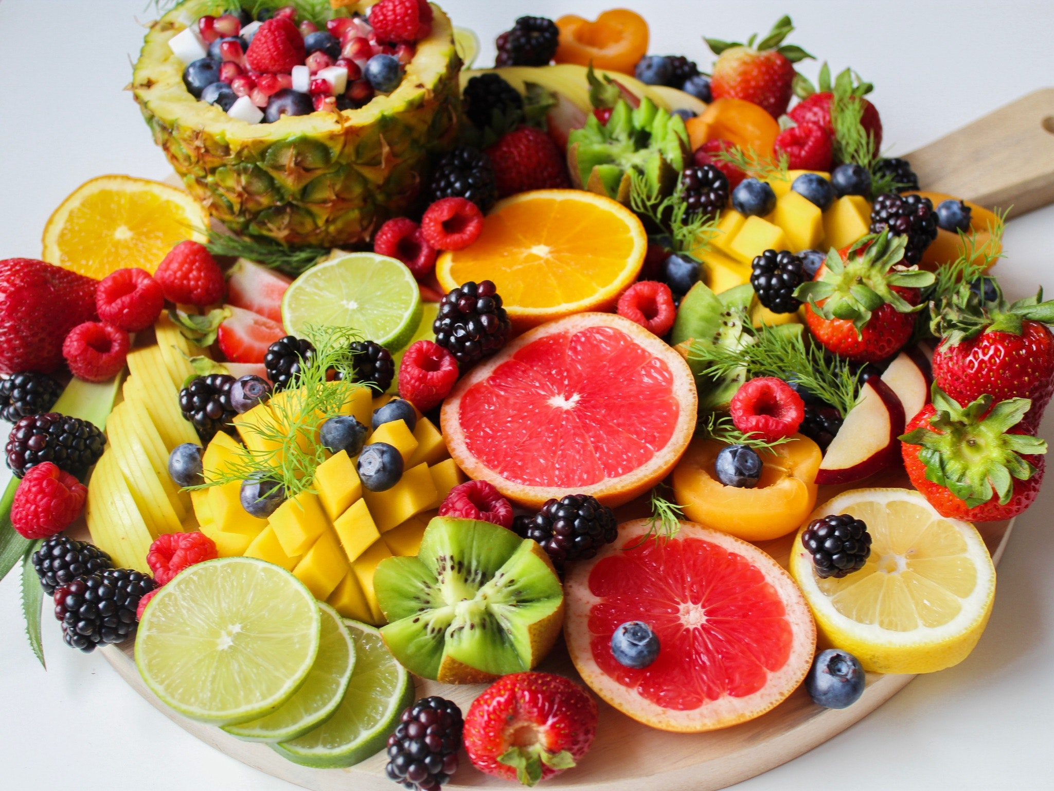
Phytochemicals And Immunity

Slide 2
Phytochemicals have been shown to have an important impact on your immune function and overall well-being. However, many people are unaware that they exist.

Slide 3
Therefore, they are often overlooked, even by those who are eager to give their health a much-needed boost.

Slide 4
In fact, phytochemicals have been researched for decades, but it’s only recently that they’ve been studied in humans.

Slide 5
So, it’s definitely worth finding out more about them and how you can add them to you daily diet.

Slide 6
What Are Phytochemicals?
Phytochemicals are plant chemicals that occur naturally and, when consumed, have been shown to interact with the immune system on every level and support it effectively.

Slide 7
They can even influence the gene activity that is involved in the development of cancer and suppress the hormones that have been shown to stimulate the growth of certain types of cancer.

Slide 8
The Most Beneficial Phytochemicals
These bioactive chemicals have been proven to slow down and halt cancer progression by inhibiting cell division, altering gene expression, reducing inflammation and free radical damage, and inhibiting the blood supply to tumors.

Slide 9
It blocks the production of hormone receptors, growth factors and the other components known to promote cancer growth.

Slide 10
Cranberries contain a number of phytochemicals including polyphenols, flavanol glycosides, proanthocyanidins, phenolic acids and anthocyanins.

Slide 11
Meanwhile, avocados are a rich source of carotenoids and pomegranates are packed with ellagic acid and hydrolysable ellagitannins, both of which are polyphenols.

Slide 12
Black tea and garlic have also been shown to be beneficial phytochemicals.

Slide 13
Eating foods that are a range of colors is one of the best ways to benefit from phytochemicals in your diet.

Slide 14
All of these compounds are known to boost immunity exponentially, so you should try every day to make sure that you include foods of several colors in your meals to give yourself the best chance of achieving optimal immunity.

