Slide 1

The Immunity Problem – An Overview

Slide 2
Your immune system has a key role to play in your body, keeping you safe from the micro-organisms that can cause diseases.

Slide 3
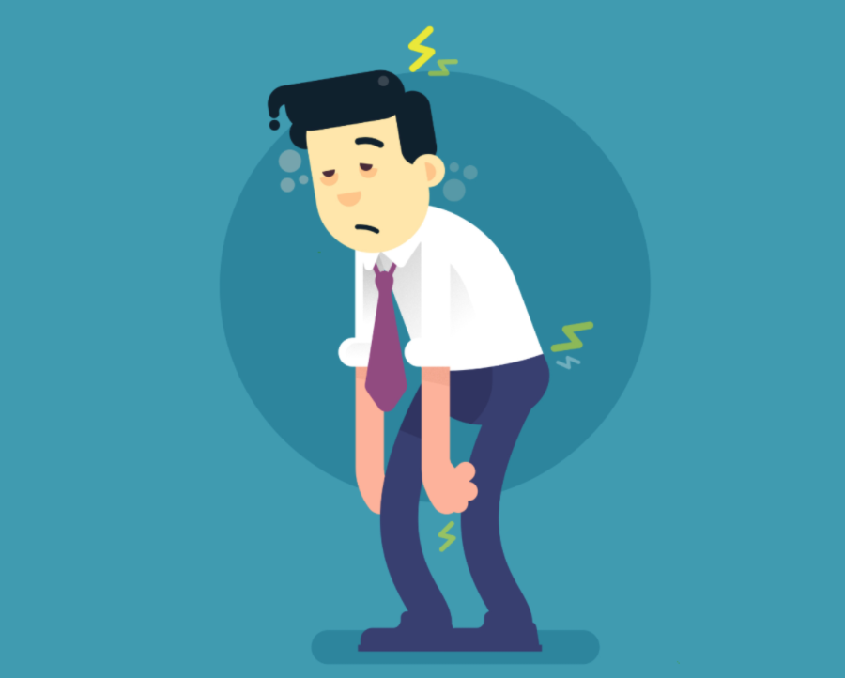
If germs successfully invade your body, you can become sick.

Slide 4
So, finding ways to intervene in this process and give your immunity a boost couldn’t be more important.

Slide 5
Without a strong immune system, the result is a disease.

Slide 6
While some of the illnesses, such as the common cold, may be mild and easily overcome, others can be much more serious and even life-threatening.

Slide 7
So, how is it possible to improve your immunity?

Slide 8
The concept of giving your immune system a boost is an enticing one, however for generations, finding ways to do it has proved to be elusive.

Slide 9
Even today, researchers still lack knowledge about how the immune response interconnects, and no direct links have been scientifically proven between enhanced immune function and lifestyle.

Slide 10
Researchers have been exploring the effect of a number of factors on immune responses in humans and recommend that the best line of defense when it comes to your immunity is choosing a healthy diet.

Slide 11
How Does The Immune System Work?
Your immune system is your body’s defense from infection, attacking germs and keeping you healthy.

Slide 12
The immune system contains leukocytes or white blood cells, which have a vital part to play in destroying invading organisms.

Slide 13
When your immune system is strong, it can identify these potential threats quickly and eliminate them rapidly before they have a chance to make you unwell.

Slide 14
However, if your immunity is compromised for any reason, you’re at risk of becoming ill and suffering from a disease caused by the antigens your body has been invaded by.

Slide 15
What Affects The Immune System?
There are a number of factors that affect the immune system. These include:

Slide 16
Stress – if you’re subjected to prolonged episodes of intense stress, your immunity is impacted. This impairs the way that the T-cells that fight infection work.

Slide 17
Loneliness – if you’re lonely, your immunity can be impaired.

Slide 18
Living a sedentary lifestyle – if you sit for too long and avoid exercise, your body struggles to combat infections.

Slide 19
Excessive exercise – while a sedentary life affects your immune system, so does extreme exercise.

Slide 20
Nicotine – exposure to nicotine, either through regular cigarettes or vaping can harm your immunity.

Slide 21
UV radiation – harmful ultraviolet rays can weaken your immune system, affecting the cells that trigger immune responses and lowering your defenses.

Slide 22
Diet – if you eat unhealthy foods like saturated fats, sugar and salt, you are at risk of obesity.

Slide 23
Alcohol – excessive alcohol consumption reduces your immune response to any invading pathogens.

Slide 24
Alcohol also negatively affects the body’s process of breaking down and attacking viruses and bacteria increasing the risk of infection.

Slide 25
Grief – a tragic event may weaken your immune response by boosting the hormones and nerve chemicals that put you at a greater risk of viral infections.

Slide 26
Ways Of Boosting Your Immunity
Modern medicine has acknowledged that the body and mind have a strong link.

Slide 27
Therefore, one way to improve your immunity is to try to limit the stress in your life.

Slide 28
Taking regular moderate exercise will also help to naturally give your immunity a boost.

Slide 29
Your immune system requires regular, good nourishment to function properly.

Slide 30
Deficiencies in micronutrients like selenium, zinc, folic acid, iron, and vitamins E, B6, C, and A can alter your immune response.

Slide 31
It’s possible to buy supplements that can support your immunity but it’s best to try to achieve this by eating a healthier diet.

Slide 32
Immunity And Your Age
Most of us are aware that, as we get older, we experience more diseases and are more at risk from any viruses that are out there.

Slide 33
However, we don’t always recognize why this is the case.

Slide 34
Although some people get older and remain healthy, the elderly have been shown to be more at risk of infectious diseases.

Slide 35
Older people often eat less food, in general, and have a less varied diet.

Slide 36
This can lead to micronutrient malnutrition which is known to reduce immunity.

Slide 37
With a diet that is rich in vitamins, minerals, and other important nutrients, it’s possible to enjoy a healthy lifestyle right through your later years.

