Slide 1
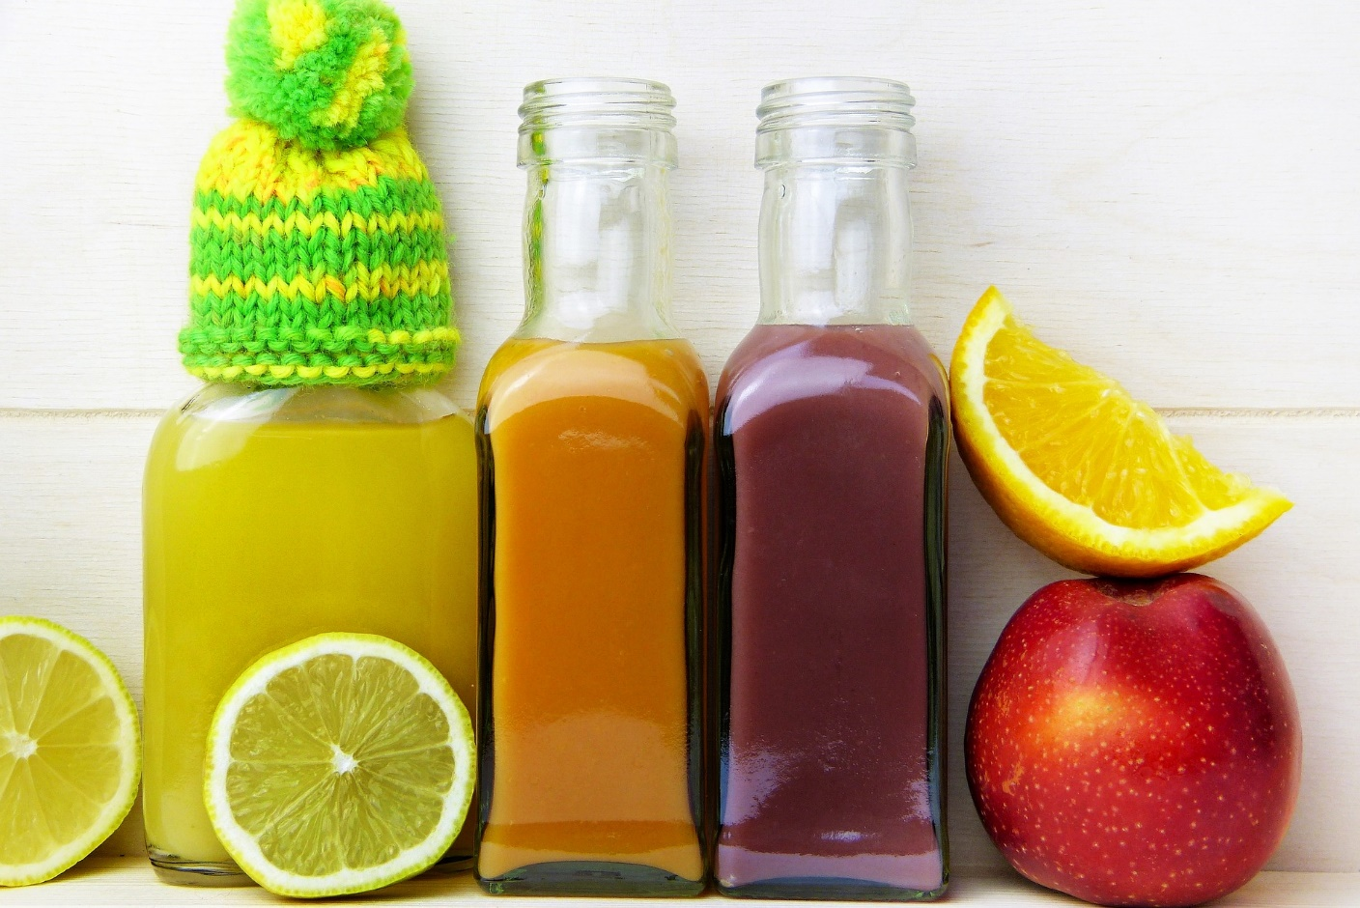
How To Maximize Your Intermittent Fasting Results

Slide 2
Are you ready to try intermittent fasting?

Slide 3
Whether you’re doing it for weight loss or for the other benefits, you will probably want to maximize your results.

Slide 4
Luckily, there are a few things you can do to get as much benefit as possible from your eating regime.

Slide 5
Here, we take a look at some things you can try to speed your weight loss.

Slide 6
Exercise And Intermittent Fasting
There is some research to show that if you exercise while fasting, there are additional benefits.

Slide 7
This is linked to your insulin sensitivity and blood sugar level. This means you’ll burn more fat.

Slide 8
To get the best result, eat protein following your workout. This will build and maintain your muscles.

Slide 9
You should also follow up strength training with carbs within a half hour of your workout.

Slide 10
It’s wise to eat food close to any modern or high-intensity exercise session.

Slide 11
Keeping up your electrolyte level is important. Coconut water can be useful for this.

Slide 12
You may feel a little lightheaded or dizzy if you work out while fasting.

Slide 13
If you’re doing a longer fast, you may find gentle exercise like pilates, yoga or walking are better.

Slide 14
Choosing The Right Regime For You
To maximize the results of your intermittent fasting, you’ll need to choose the right regime.

Slide 15
Not all are suitable for everyone. You need to find one that works well for your lifestyle and that makes your life easier.

Slide 16
When you choose the right regime, you’ll stick to it in the long-term.

Slide 17
So, here are some questions to ask yourself to help you choose wisely.

Slide 18
Are you already eating healthily?

Slide 19
Fasting is harder if you’re currently eating a standard American diet.

Slide 20
If you jump straight into extreme fasting, you’ll experience symptoms of withdrawal from sugar.

Slide 21
If you usually eat processed foods regularly, try beginning with a short fasting window.

Slide 22
Stop snacking and introduce wholefoods into your diet.

Slide 23
On the other hand, if you already eat healthily, you can start with a longer fast window.

Slide 24
Can you manage to go for long periods without eating?

Slide 25
Some people are able to manage fasting for a whole day. You may need to experiment. Focus on the way fasting makes you feel.

Slide 26
If you find it easy, you may be able to opt for a 36-hour fast straight away.

Slide 27
How does your schedule look?

Slide 28
It’s easier to fast if you’re busy and distracted from thinking about food.

Slide 29
If you work out, you may want to end your fasting window straight after exercising.

Slide 30
If you answer these questions, you’ll be best-placed to choose the right regime to suit your life and preferences. This will give you the best chance of success.

Slide 31
Adding In Keto
Some experts say that if you combine intermittent fasting with the keto diet, you’ll lose more weight. So, what does this involve?

Slide 32
The keto (or ketogenic) diet is a specific way of eating in which most calories come from healthy fats.

Slide 33
Very few, if any, carbohydrates are consumed on this diet.

Slide 34
This low-carb, high-fat diet encourages your body to burn fat, not sugars, to produce energy.

Slide 35
It produces ketones and they are then used as a fuel for energy. The process is known as ketosis. Hence the name “keto”.

Slide 36
Like intermittent fasting, keto diets have a number of benefits. They can boost weight loss, reduce your blood sugar level and improve your brain function.

Slide 37
If you combine keto dieting with IF, the amount of time you’re in ketosis increases.

Slide 38
This could make you feel more energetic, less hungry and speed your weight loss.

