Slide 1
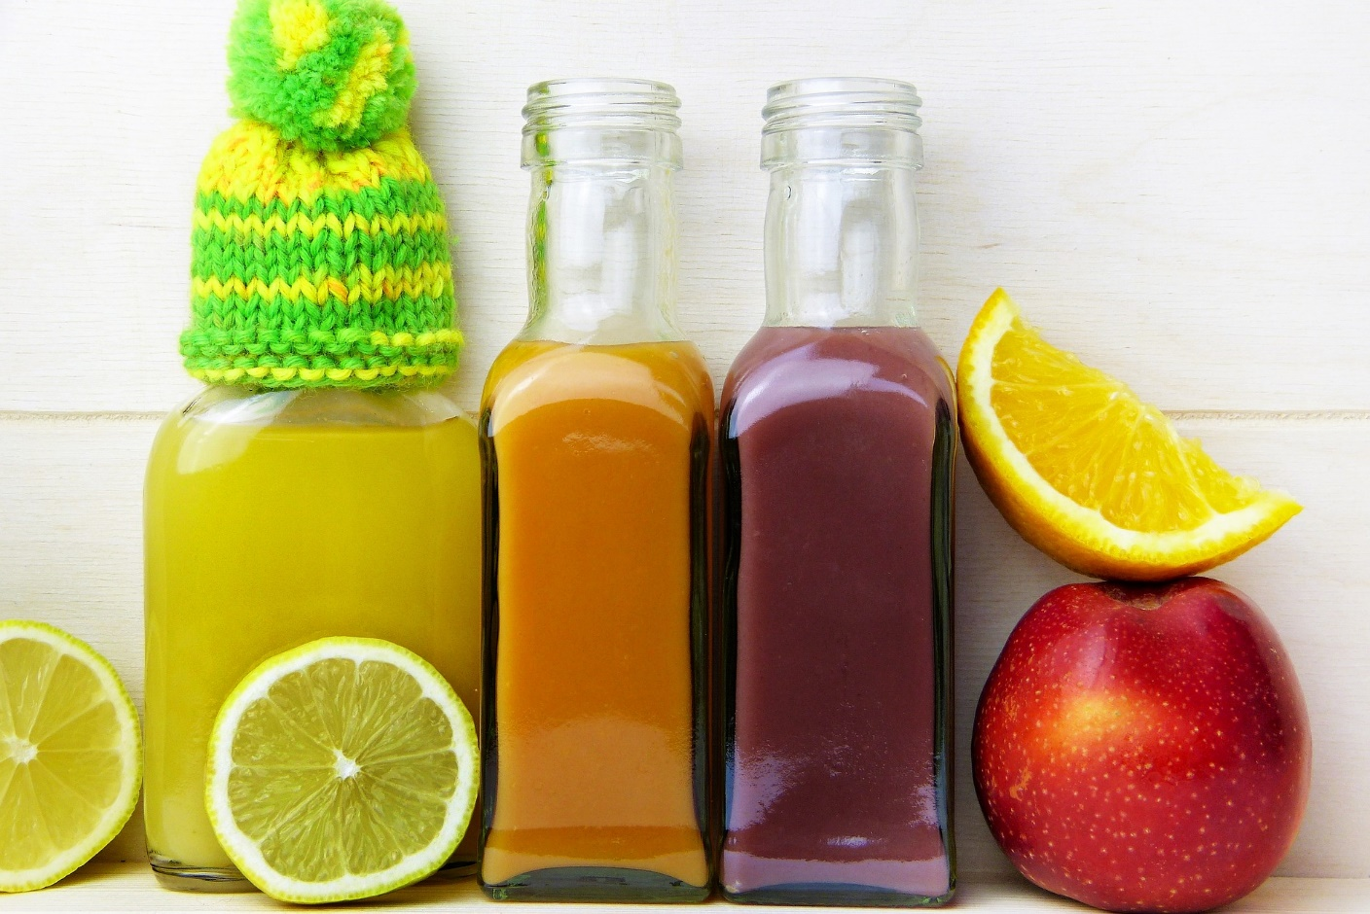
Other Types Of Intermittent Fasting

Slide 2
Although 24-hour and 16:8 intermittent fasting are the two most popular types, there are several others.

Slide 3
Here, we’ll take a closer look at five other kinds of fasting regimes that several people follow.

Slide 4
20:4 Fasting
20:4 fasting is sometimes called the Warrior Diet. It was one of the earliest diets to involve intermittent fasting.

Slide 5
This large meal takes place in a four-hour eating window.

Slide 6
During the other 20 hours of the day, only small amounts of raw vegetables and fruits can be eaten.

Slide 7
They should be unprocessed wholefoods that contain no artificial ingredients.

Slide 8
A timetable for this diet looks like this:
Mon | Tues | Wed | Thurs | Fri | Sat | Sun
Midnight – 4 p.m. – small amounts of fruit and vegetables | Midnight – 4 p.m. – small amounts of fruit and vegetables | Midnight – 4 p.m. – small amounts of fruit and vegetables | Midnight – 4 p.m. – small amounts of fruit and vegetables | Midnight – 4 p.m. – small amounts of fruit and vegetables | Midnight – 4 p.m. – small amounts of fruit and vegetables | Midnight – 4 p.m. – small amounts of fruit and vegetables
4 p.m.- 8 p.m. – Large Meal | 4 p.m. - 8 p.m. – Large Meal | 4 p.m. - 8 p.m. – Large Meal | 4 p.m. - 8 p.m. – Large Meal | 4 p.m. - 8 p.m. – Large Meal | 4 p.m. - 8 p.m. – Large Meal | 4 p.m. - 8 p.m. – Large Meal
8 p.m. -midnight - fast | 8 p.m. -midnight – fast | 8 p.m. -midnight – fast | 8 p.m. -midnight – fast | 8 p.m. -midnight – fast | 8 p.m. -midnight – fast | 8 p.m. -midnight - fast

Slide 9
5:2 Fasting
This popular form of intermittent fasting involves eating normally for five days every week.

Slide 10
The remaining two days, calories should be restricted to 500 – 600.

Slide 11
Women are recommended to eat 500 calories on their fasting days. Men can have 600 calories on their fast days.

Slide 12
You can choose which two days you prefer to fast. However, it’s best if they aren’t consecutive.

Slide 13
Many people prefer to eat two meals of 250/300 calories each.

Slide 14
This is a sample timetable for this way of eating:
Mon | Tues | Weds | Thurs | Fri | Sat | Sun
Eat normally | Eat 500/600 calories | Eat normally | Eat normally | Eat 500/600 calories | Eat normally | Eat normally

Slide 15
36-Hour Fasting
The 36-hour fast plan means you’ll be fasting for a full day.

Slide 16
Unlike the Eat-Stop-Eat method, you won’t be eating something every calendar day.

Slide 17
If, for example, you finish dinner at 7 p.m. on day one, you skip all your meals on day two. This equals a 36-hour fast.

Slide 18
There is some evidence to suggest this kind of fasting period can produce a quicker result.

Slide 19
It may also be more problematic though since you’ll be going for extended periods without food.

Slide 20
A timetable for this eating plan looks like this:
Mon | Tues | Weds | Thurs | Fri | Sat | Sun
Midnight - 7 a.m. Eat normally | Midnight - 7 a.m. Fast | Midnight – 7 a.m. Fast | Midnight - 7 a.m. Eat normally | Midnight - 7 a.m. Eat normally | Midnight - 7 a.m. Eat normally | Midnight - 7 a.m. Eat normally
7 a.m. – 7 p.m. Eat normally | 7 a.m. – 7 p.m. Fast | 7 a.m. – 7 p.m. Eat normally | 7 a.m. – 7 p.m. Eat normally | 7 a.m. – 7 p.m. Eat normally | 7 a.m. – 7 p.m. Eat normally | 7 a.m. – 7 p.m. Eat normally
7 p.m. – midnight Fast | 7 p.m. -midnight Fast | 7 p.m. – midnight Eat normally | 7 p.m. – midnight Eat normally | 7 p.m. – midnight Eat normally | 7 p.m. – midnight Eat normally | 7 p m – midnight Eat normally

Slide 21
Alternate Day Fasting
This way of fasting means that you fast for a full 24 hours every alternate day. Others only allow you to have calorie-free beverages.

Slide 22
This isn’t the best option for any newcomers to intermittent fasting.

Slide 23
This is hard to maintain in the long-term.

Slide 24
A timetable for this way of eating looks like this:
Mon | Tues | Weds | Thurs | Fri | Sat | Sun
midnight-midnight Eat normally | Midnight-midnight Fast | Midnight – midnight Eat Normally | Midnight – midnight Fast | Midnight – Midnight Eat normally | Midnight – Midnight Fast | Midnight – midnight Eat normally

Slide 25
Extended Fasts
Following the 16:8 or Eat-Stop-Eat method is quite simple. They prefer to do a 42-hour fast.

Slide 26
This involves eating dinner on day 1, say at 6 p.m. On day 3, you would then eat your breakfast at noon.

Slide 27
If you try this way of eating, you shouldn’t restrict your calorie intake during your eating window.

Slide 28
It’s technically possible to extend fasts for longer periods of time. Of course, that isn’t recommended!

Slide 29
Some people do try 7 to 14 day fasts due to the theoretical benefits they are said to provide.

Slide 30
Some people say that a seven-day fast can help prevent cancer. Others say that longer fasts promote mental clarity.

Slide 31
These benefits are unproven and are theoretical. It’s probably best, therefore, to stick to one of the tried and tested IF plans outlined above.

