Slide 1
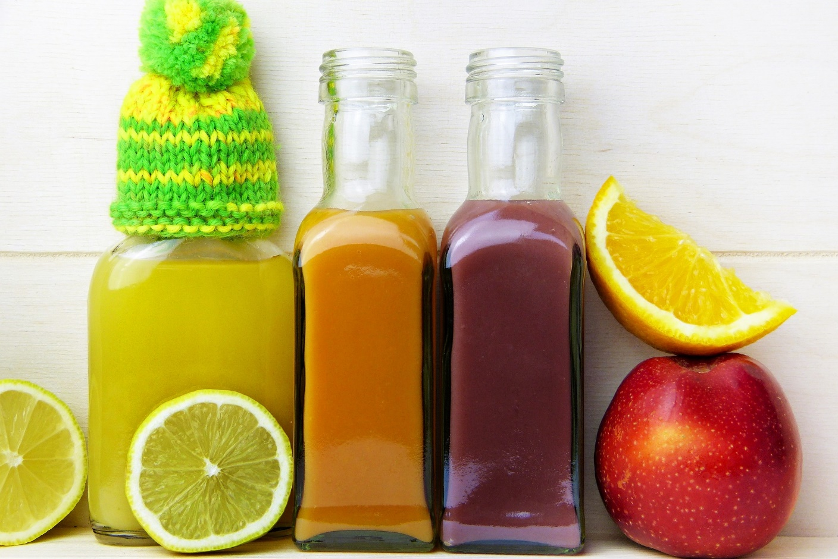
A Protocol For 16:8 Intermittent Fasting

Slide 2
If you’re keen to try intermittent fasting, you may want to start with 16:8 fasting.

Slide 3
It is one of the most popular forms of this way of eating. If you’re ready to get started, here is a protocol for 16:8 IF.

Slide 4
Choosing An Eating Window
When you’re ready to begin 16:8 fasting, the first thing to do is choose an eating window.

Slide 5
Therefore, you can choose the right time to suit your preferences and lifestyle.

Slide 6
How do you choose the right hours for you? Lots of people like an eating window of noon to 8 p.m.

Slide 7
They can even add in a couple of healthy snacks into their regime.

Slide 8
For people who would prefer to have three meals a day, a 9 a.m. – 5 p.m. eating window may be best.

Slide 9
Others prefer to wait until early afternoon to break their fast then to have their last meal later before bed.

Slide 10
Whichever eating window you choose, make sure it’s one that fits with your lifestyle patterns.

Slide 11
If you choose wrongly you won’t be able to stick to your diet.

Slide 12
Planning Healthy Foods
To maximize the benefits of the 16:8 diet, you should eat healthy foods as much as possible.

Slide 13
This will help you to stick to your new way of eating in the long-term.

Slide 14
While you can enjoy some snacks and treats, you should balance every meal with a variety of wholefoods.

Slide 15
Some of the best include:
Fruits like bananas, apples, oranges, pears, peaches and berries
Vegetables like tomatoes, leafy greens, cucumbers, cauliflower and broccoli

Slide 16
Wholegrains like oats, rice, quinoa, buckwheat and barley
Healthy fats like coconut oil, avocados and olive oil
Lean protein like poultry, fish, seeds, nuts, eggs and legumes

Slide 17
If you binge on junk food, you could end up negating the benefits of this diet.

Slide 18
Therefore, you should still keep unhealthy choices to a minimum.

Slide 19
Choosing Calorie-Free Beverages
You can drink any of your preferred beverages during your eating window.

Slide 20
If you drink several family-sized bottles of full-fat soda you probably won’t lose weight!

Slide 21
In your fasting window, you need to only consume calorie-free beverages. This spoils your entire eating regime.

Slide 22
Water, green tea, unsweetened coffee and tea without milk are all good choices.

Slide 23
A Weekly Timetable
Your weekly 16:8 eating timetable will vary depending on which eating window you choose.

Slide 24
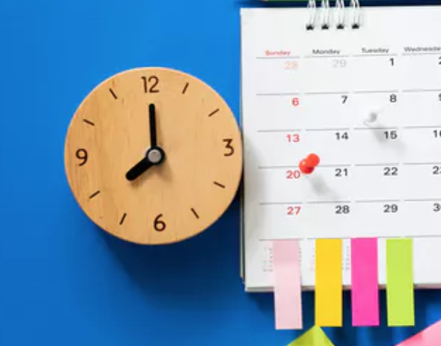
Here are three samples to suit different schedules:

Slide 25
Early Eating Meal Plan
Mon | Tues | Wed | Thurs | Fri | Sat | Sun
8 a.m. - breakfast | 8 a.m. - breakfast | 8 a.m. - breakfast | 8 a.m. - breakfast | 8 a.m. - breakfast | 8 a.m. - breakfast | 8 a.m. - breakfast
10 a.m. snack | 10 a.m. snack | 10 a.m. snack | 10 a.m. snack | 10 a.m. snack | 10 a.m. snack | 10 a.m. snack
12 noon - lunch | 12 noon - lunch | 12 noon - lunch | 12 noon - lunch | 12 noon - lunch | 12 noon - lunch | 12 noon – lunch
Evening – calorie-free beverages | Evening – calorie-free beverages | Evening – calorie-free beverages | Evening – calorie-free beverages | Evening – calorie-free beverages | Evening – calorie-free beverages | Evening – calorie-free beverages

Slide 26
Average Eating Meal Plan
Mon | Tues | Wed | Thurs | Fri | Sat | Sun
9 a.m. – calorie-free beverage | 9 a.m. – calorie-free beverage | 9 a.m. – calorie-free beverage | 9 a.m. – calorie-free beverage | 9 a.m. – calorie-free beverage | 9 a.m. – calorie-free beverage | 9 a.m. – calorie-free beverage
11 a.m. - breakfast | 11 a.m. - breakfast | 11 a.m. - breakfast | 11 a.m. - breakfast | 11 a.m. - breakfast | 11 a.m. - breakfast | 11 a.m. - breakfast
2 p.m. lunch | 2 p.m. lunch | 2 p.m. lunch | 2 p.m. lunch | 2 p.m. lunch | 2 p.m. lunch | 2 p.m. lunch
4 p.m. snack | 4 p.m. snack | 4 p.m. snack | 4 p.m. snack | 4 p.m. snack | 4 p.m. snack | 4 p.m. snack
6 p.m. dinner | 6 p.m. dinner | 6 p.m. dinner | 6 p.m. dinner | 6 p.m. dinner | 6 p.m. dinner | 6 p.m. dinner

Slide 27
Late Eating Meal Plan
Mon | Tues | Wed | Thurs | Fri | Sat | Sun
11 a.m. – calorie-free beverage | 11 a.m. – calorie-free beverage | 11 a.m. – calorie-free beverage | 11 a.m. – calorie-free beverage | 11 a.m. – calorie-free beverage | 11 a.m. – calorie-free beverage | 11 a.m. – calorie-free beverage
1 p.m. snack | 1 p.m. snack | 1 p.m. snack | 1 p.m. snack | 1 p.m. snack | 1 p.m. snack | 1 p.m. snack
4 p.m. lunch | 4 p.m. lunch | 4 p.m. lunch | 4 p.m. lunch | 4 p.m. lunch | 4 p.m. lunch | 4 p.m. lunch
6 p.m. snack | 6 p.m. snack | 6 p.m. snack | 6 p.m. snack | 6 p.m. snack | 6 p.m. snack | 6 p.m. snack
9 p.m. dinner | 9 p.m. dinner | 9 p.m. dinner | 9 p.m. dinner | 9 p.m. dinner | 9 p.m. dinner | 9 p.m. dinner

