Slide 1
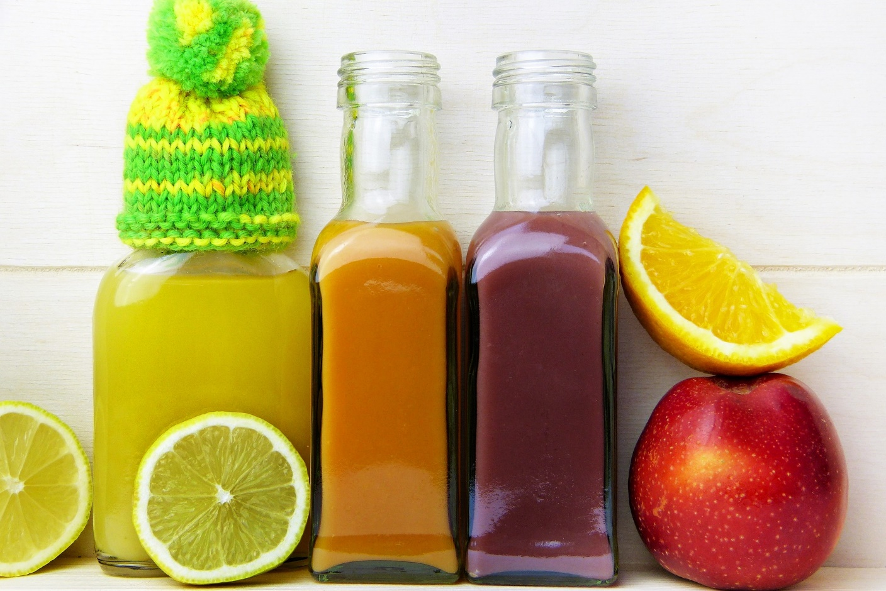
Addressing Common Questions

Slide 2
When you’re keen to start intermittent fasting, you’ll want all the information you need at your fingertips.

Slide 3
Here, we address some of the most common questions about intermittent fasting.

Slide 4
Hopefully, the answers will help you to make a final decision about whether IF could be right for you.

Slide 5
Exercise And Fasting
Many people wonder whether they can carry on exercising if they’re fasting.

Slide 6
It may take a little time, though, to adjust to your new regime.

Slide 7
Some people worry that they’ll lose muscle if they fast. This is something that is a danger with any diet. However, you can avoid this happening.

Slide 8
It’s advisable to exercise at the end of your fasting period. If you break your fast at that time, you’ll feel satisfied.

Slide 9
What Should You Eat During Your Eating Window?
When you follow an IF lifestyle, there are no restrictions about what you can eat in your eating window.

Slide 10
You aren’t restricted to amounts or specific food types. However, it’s wise to remember that you should still make healthy choices.

Slide 11
The best solution is to eat a balanced diet in your eating window.

Slide 12
Foods that are dense in nutrients like seeds, beans, nuts, wholegrains, vegetables and fruits are good choices.

Slide 13
There are certain foods that are especially beneficial if you follow this way of eating:
Avocados – yes, they’re high in calorie. However, they are packed with monounsaturated fats. This makes them very satiating.

Slide 14
Fish – you should try to eat a minimum of 8 ounces of fish every week. Fish is packed with protein, healthy fats and vitamin D.
Cruciferous vegetables – foods such as cauliflower, Brussels sprouts and broccoli are good choices.

Slide 15
Potatoes – many people worry that potatoes are bad for you. However, they’re very satisfying and will keep you full for longer.

Slide 16
Legumes and beans – although these are carbs, they’re low calorie and give you lots of energy. They are also packed with protein and fiber.

Slide 17
Probiotics – eating foods rich in probiotics like sauerkraut, kefir and kombucha helps keep your gut happy.
Berries – strawberries, blueberries and others are packed with nutrients like vitamin C.

Slide 18
Eggs – every egg has a massive 6 grams of protein. Simple and quick to cook, eggs make you feel full.
Nuts – yes, nuts are high in calories. However, they’re packed with polyunsaturated fat that helps you feel full.

Slide 19
Wholegrains – yes, wholegrains are also carbs! However, they’re full of protein and fiber. A study has even shown that eating wholegrains can boost your metabolism.

Slide 20
What Can You Have In Your Fasting Period?
What can you have in your fasting period? The answer depends on which fast you’re doing.

Slide 21
If you’re doing the 5:2 diet, you can eat up to 500 or 600 calories on your fast days.

Slide 22
So, you can maximize the amount you can eat by including lots of low calorie, high-nutrient foods

Slide 23
If you’re doing any of the other fasting methods, you can’t eat any solid foods at all.

Slide 24
Luckily, though, there are lots of beverages you can have to stay hydrated.

Slide 25
It’s obvious that you should have lots of water in your fasting window.

Slide 26
If you wish, you can add a squeeze of lime or lemon for a little more flavor.

Slide 27
You can’t add any artificially-sweetened enhancers though. These could damage your fast.

Slide 28
Another good beverage for your fasting period is black coffee. You can have decaffeinated or regular coffee but don’t add milk or sweeteners.

Slide 29
Some people say that black coffee could enhance IF’s benefits. It can also help to support a healthy level of blood sugars in the long-run.

Slide 30
Some people find that if they drink coffee during their fast they get an upset stomach or racing heart. You may need to take care to monitor how you feel if you drink black coffee.

Slide 31
If you’re fasting for 24-hours or longer, try vegetable or bone broth.

Slide 32
It’s full of artificial preservatives and flavors that will damage your fast. Make it at home for the best results.

Slide 33
Tea can also help you to feel full. You can drink any type of tea in your fasting window.

Slide 34
Tea also helps to improve your fasting by supporting cellular and gut health as well as probiotic balance.

Slide 35
Apple cider vinegar offers many health benefits. It will support your blood sugar level and digestion. It could even boost the results of your fasting.

Slide 36
There are, however, some drinks that you need to avoid while you’re fasting. While diet sodas technically have no calories, they’ve been shown to inhibit fasting’s positive effects.

Slide 37
These trigger your insulin response. You should therefore avoid drinking them in your fast window.

Slide 38
Many people ask whether they can have coconut water or almond milk in their fast period.

Slide 39
Since sugar is a carbohydrate, you’ll no longer be fasting if you consume it.

Slide 40
One very common question is whether it’s possible to drink alcohol if you’re doing an IF diet.

Slide 41
This is because most alcoholic drinks contain a lot of calories and sugar. Also, alcohol will have more effect on you if you have an empty stomach.

Slide 42
Can Children Try Intermittent
Fasting?
There is no specific evidence to say whether it’s safe for children to try intermittent fasting or not.

Slide 43
Others say it’s a bad idea since children are going through a period of rapid growth.

Slide 44
Children need to eat enough protein, vitamins and minerals. It’s probably wise to speak to a doctor before putting a child on an IF diet.

Slide 45
Is Fasting Unhealthy?
It’s only natural for people to ask whether fasting is unhealthy.

Slide 46
This could cause you to put on weight, not lose it. Therefore, they say, fasting is unhealthy.

Slide 47
However, this isn’t the case at all. People have been fasting for centuries with no ill effects.

Slide 48
Ramadan have shown that extended fasting causes no health issues for most people.

Slide 49
There are a few issues to bear in mind, though. Fasting isn’t for everyone.

Slide 50
They struggle to sustain this lifestyle for extended periods. This can lead to an inconsistent eating schedule that may have unhealthy consequences.

Slide 51
There are a few other issues to consider too. This can make it hard to stick to IF in the long-run without developing an eating disorder.

Slide 52
Some binge during their eating window. It’s therefore important to approach IF with caution if you have a history of disordered eating.

Slide 53
On the whole, though, IF isn’t just not unhealthy, it can be positively good for you.

Slide 54
It can improve your metabolism and your insulin resistance.

Slide 55
It can also decrease your inflammation and boost your cell repair as well as support a healthier gastrointestinal tract.

