Slide 1
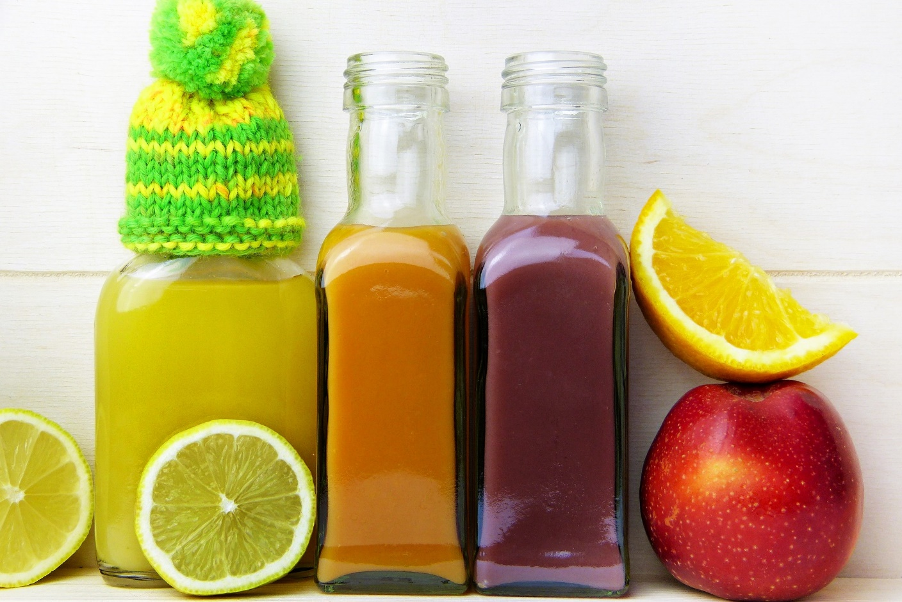
How To Get Started With Intermittent Fasting

Slide 2
If you’re convinced of the benefits of intermittent fasting, you’ll need to know how to get started.

Slide 3
So, how can you get yourself off to the best possible start? Here are some top tips.

Slide 4
Starting With A Less Rigorous Regime
It may be tempting to try to lose as much weight as possible by starting out with a long fast.

Slide 5
However, bear in mind this may not be the best approach.

Slide 6
If you’re used to a high-carb, high-sugar, processed foods diet, you’ll struggle to fast for 36 hours straight off.

Slide 7
If you find your first fast impossibly hard, you’ll probably put off the whole idea.

Slide 8
It’s recommended to try any intermittent fasting plan for at least a month.

Slide 9
It will be very difficult for someone inexperienced to stick to an extended fast regime in the long-term.

Slide 10
It’s therefore best to opt for one of the less rigorous regimes to start with.

Slide 11
In fact, you can eat your regular meals on five days of the week. The other two, you still get 500 or 600 calories to play with.

Slide 12
Choose your meals wisely, and you’ll experience the benefits without ever feeling hungry.

Slide 13
Alternatively, try the popular 16:8 method. For a large proportion of your fasting time you’ll be asleep.

Slide 14
Many people like the freedom that this offers. When they get used to the 16-hour fast, they find this way of eating quite simple.

Slide 15
If you want to work up to longer fasts once you’re used to fasting, you can.

Slide 16
However, many people continue to follow their initial plan in the long-term and experience good results.

Slide 17
Staying Hydrated
Whatever type of intermittent fasting plan you try, you need to stay well-hydrated.

Slide 18
It doesn’t mean you can’t have water and other calorie-free drinks. In fact, you should drink more of them!

Slide 19
Staying hydrated will ensure that toxins can be flushed effectively from your body.

Slide 20
It will also help you to stay healthy in other ways.

Slide 21
You’ll also avoid headaches and other problems associated with dehydration.

Slide 22
Drinking calorie-free beverages during your fasting window can also help to prevent you from feeling hungry.

Slide 23
If you drink a glass of water when you’re beginning to feel hungry, you’ll continue fasting for longer.

Slide 24
Try Experimenting With Different Eating Patterns
We have suggested some eating plan timetables above, however that doesn’t mean you need to stick to them.

Slide 25
They may not work for you. You need to choose the right days and eating patterns to fit your lifestyle, preferences and needs.

Slide 26
Perhaps you prefer to begin eating as soon as you get up and then have your last meal early.

Slide 27
You may prefer to fast at the weekend so you don’t need to worry about feeling tired at work.

Slide 28
There is no single perfect IF plan for everyone. That means you may need to do a little experimentation.

Slide 29
Think about which one you’re most drawn to and give it a try.

Slide 30
If you’re having problems, it’s time to go back to the drawing board.

Slide 31
Try a different intermittent fasting regime to see if that better suits your lifestyle.

Slide 32
Don’t be afraid to experiment – after all, experimentation could be the key to success.

